Slide 1
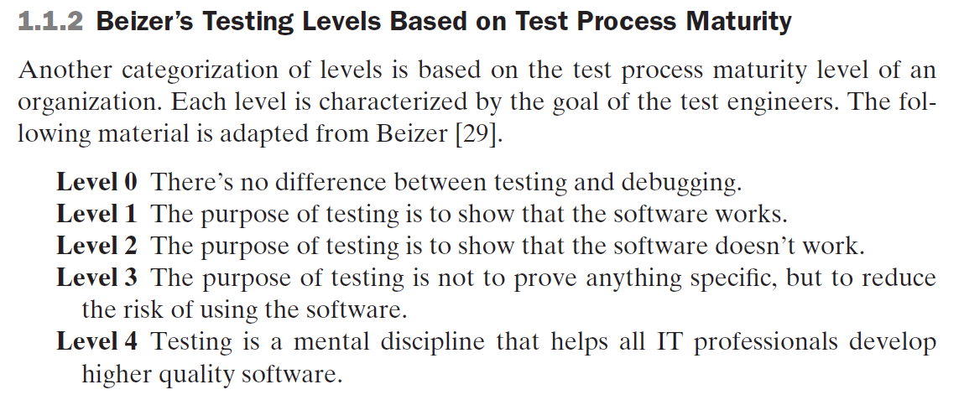

Slide 2
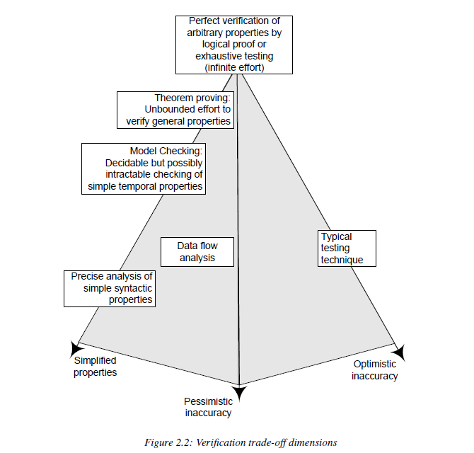

Slide 3
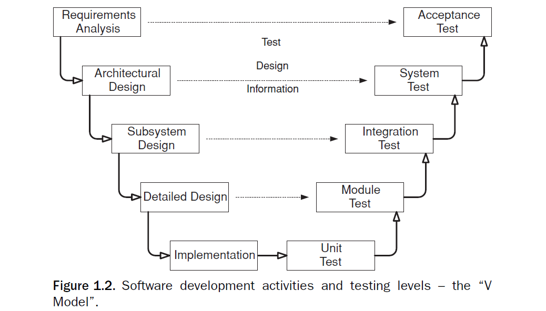

Slide 4
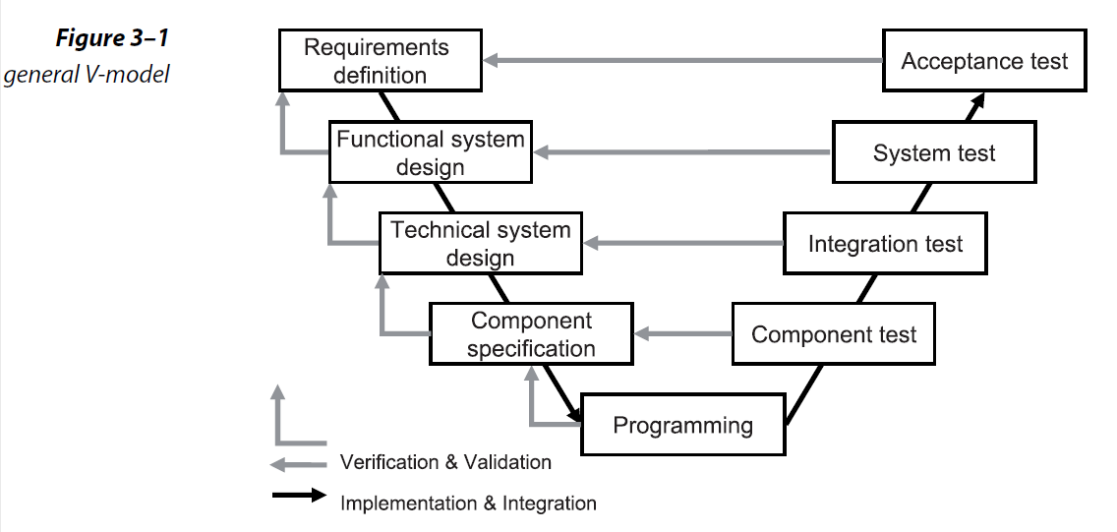

Slide 5
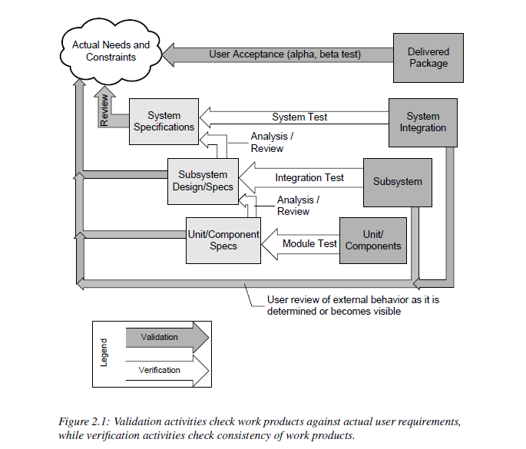

Slide 6
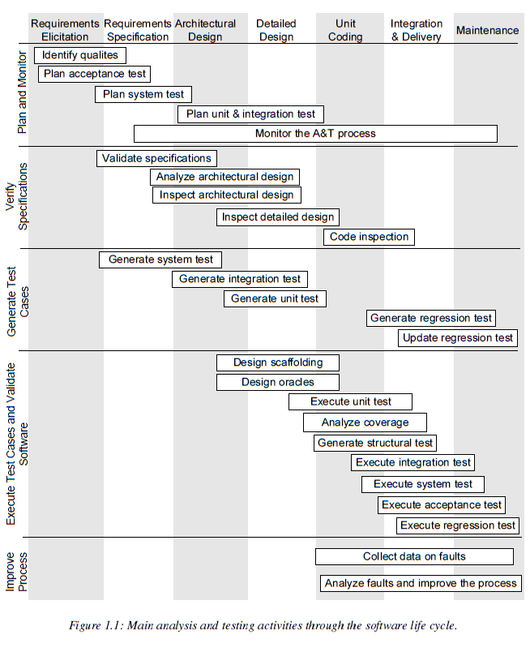

Slide 7
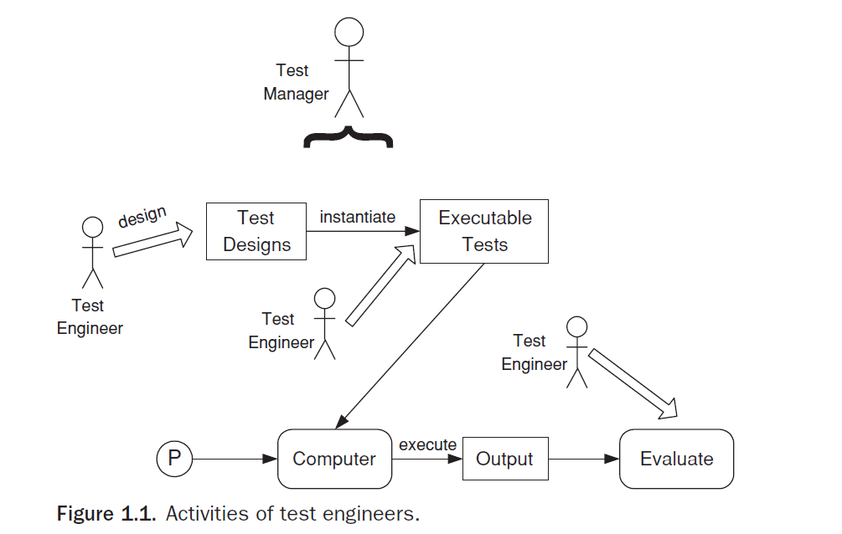

Slide 8
تعريف Error, fault, failure
Fault: Should start searching at 0, not 1
public static int numZero (int [ ] arr)
{ // Effects: If arr is null throw NullPointerException
// else return the number of occurrences of 0 in arr
int count = 0;
for (int i = 1; i < arr.length; i++)
{
if (arr [ i ] == 0)
{
count++;
}
}
return count;
}
Test 1
[ 2, 7, 0 ]
Expected: 1
Actual: 1
Error: i is 1, not 0, on the first iteration
Failure: none
Test 2
[ 0, 2, 7 ]
Expected: 1
Actual: 0
Error: i is 1, not 0
Error propagates to the variable count
Failure: count is 0 at the return statement

Slide 10
