Slide 6
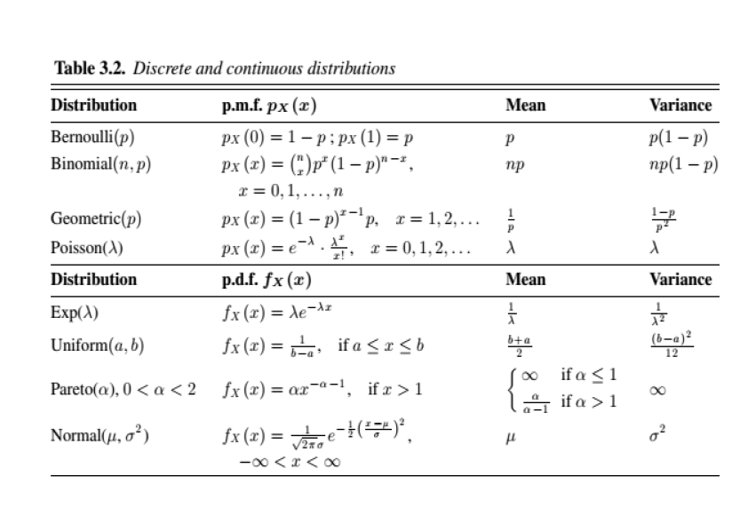

Slide 10
1

Slide 11
0

